Slide 1

EEY4189 – Software Design in Group
Road Traffic Management System
By: Group 3.5
Team Name : Traffic 24 Team
Members
P. Komathy
S. Thanujan
(S92065503). (S18007700).

Slide 2

Introduction
Purpose of the project
To improve poor transport operation, reduce traffic jam and provide sufficient driving training ethic and law enforcement.
Scope of the project
Road Traffic Management system is a hi quality graphical module and provide premium quality of traffic violation detection and real time Traffic flow metrics.

Slide 3
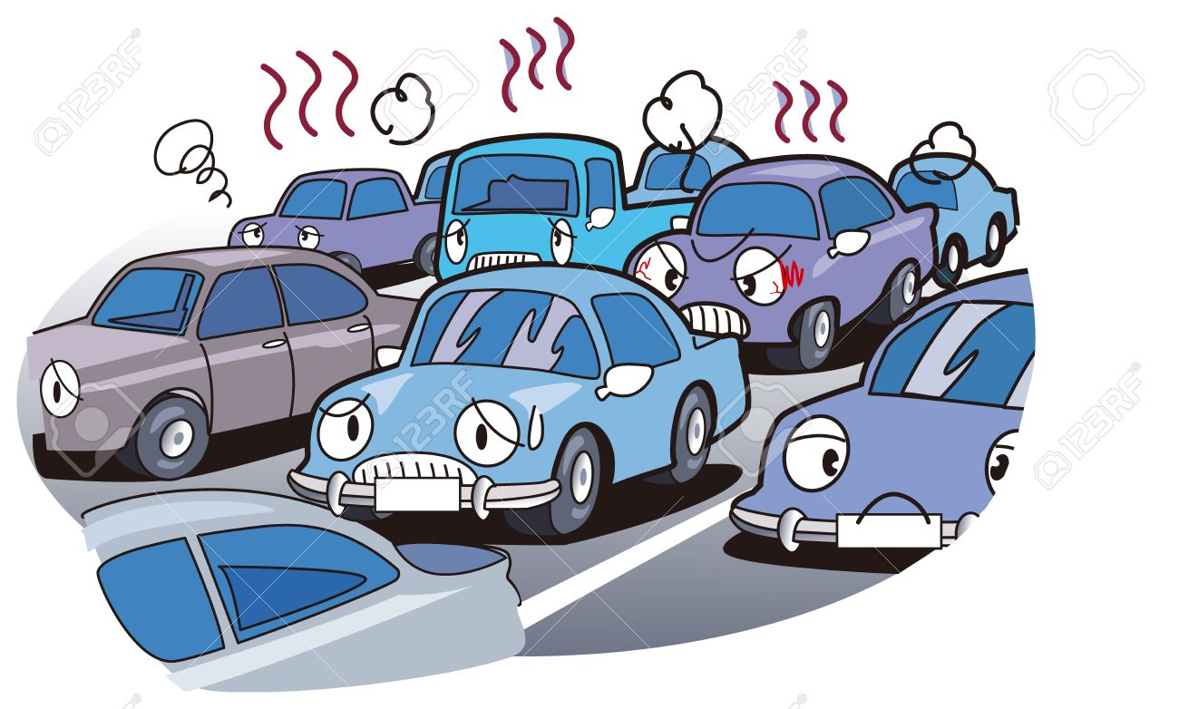
Problem Identified:
Traffic jams often occur during rush hour and it can also be caused by accidents.
The terrible situation that we all ever face once in our life. That there is nothing worse thing than being trapped in your vehicle and waiting in the middle of a traffic jam.
And also traffic violations often occurred everywhere in city. Because of
Driving without proper training
Not aware of road rules

Slide 4

How can we reduce the number of traffic jams? The best way might to solve traffic jams is by using public transportation because it will be efficient, economical, and reliable. Registering vehicle plate number with owners information and send penalty invoice or form a violated road law by traffic police Place radar cameras in rush areas in-order to capture violators
Solution for the problem:

Slide 5

Goal of the project To improve poor transport operation, reduce traffic jam and provide sufficient driving training ethic and law enforcement. Road Traffic Management system is a hi quality graphical module and provide premium quality of traffic violation detection and real time Traffic flow metrics.

Slide 6
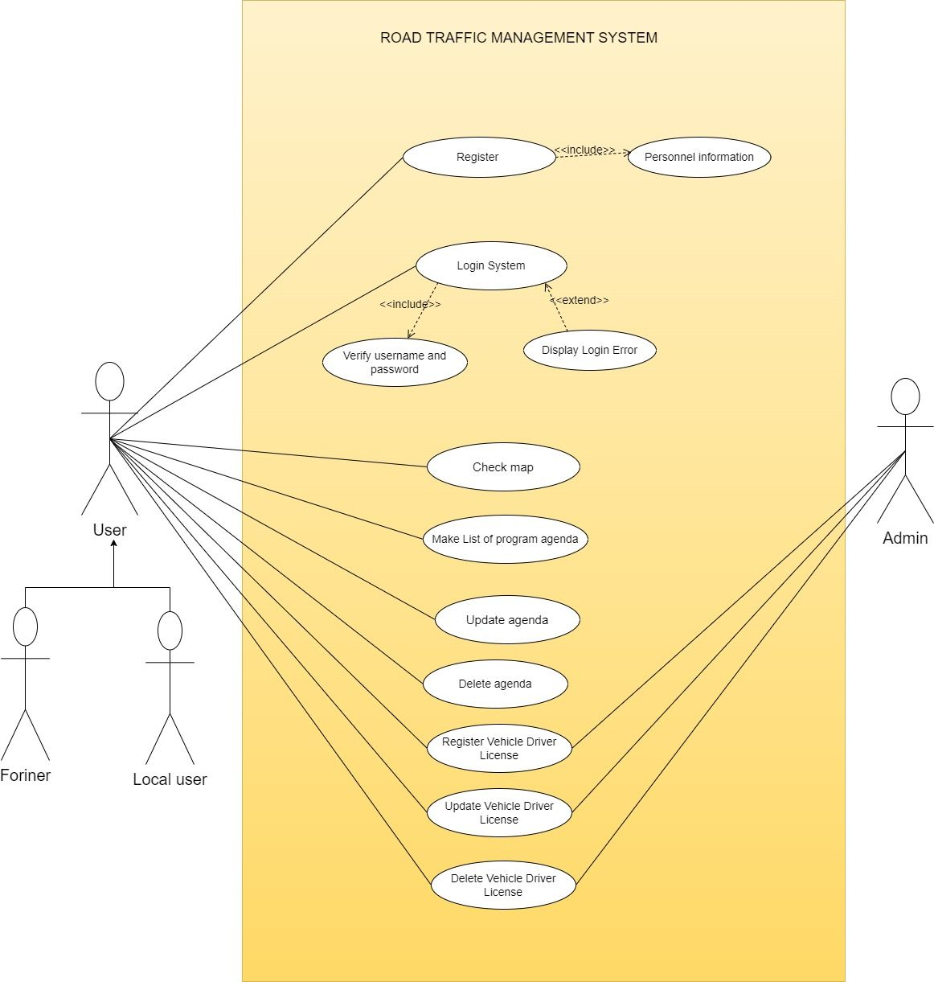
Design of the Project:
Use case diagram

Slide 7
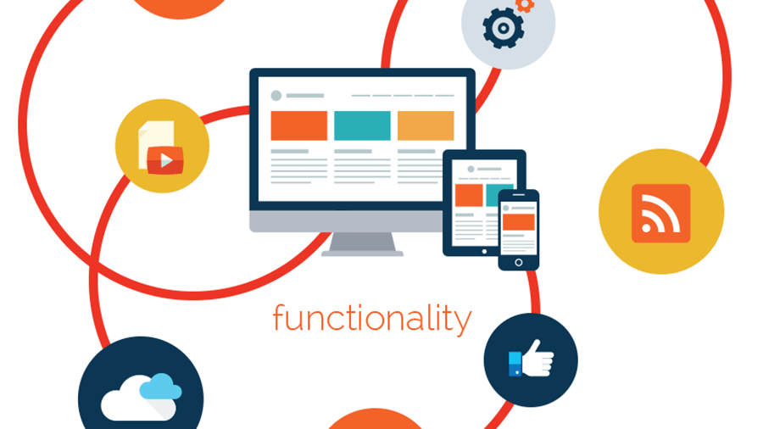
Functional & Non-Functional Requirement
What does mean by functional requirement?
In a software development environment, the system’s perspective the software functionality that developers must build into the product to enable users to accomplish their tasks.
Simply the answer for the question “What system should do?”
New user Registration
Log In & Log Out
Live Traffic Flow (by Google map)
Update and Delete user plane (CRUD)
Therefore, our system will do:

Slide 8
Functional & Non-Functional Requirement
What does mean by non-functional requirement?
Simply the answer for the question “How system should do?”
Therefore:
Usability
Security
Maintainability
Reliability
The system should have a 99.9% uptime over a given period.
Monitor and ensure that system downtime does not exceed 8.76 hours (0.1% downtime) annually.
The system should have an average user satisfaction rating of at least 4 out of 5.
Conduct regular user surveys and analyze user feedback to maintain a satisfaction rating of 80% or higher.
Implement encryption protocols to ensure the confidentiality of sensitive data.
Regularly conduct security audits and penetration testing, with zero critical vulnerabilities identified during each assessment
The system should be designed to allow for easy updates and modifications without causing disruptions.
Evaluate the time required to implement a system update or modification, aiming for an average of less than 4 hours.

Slide 9
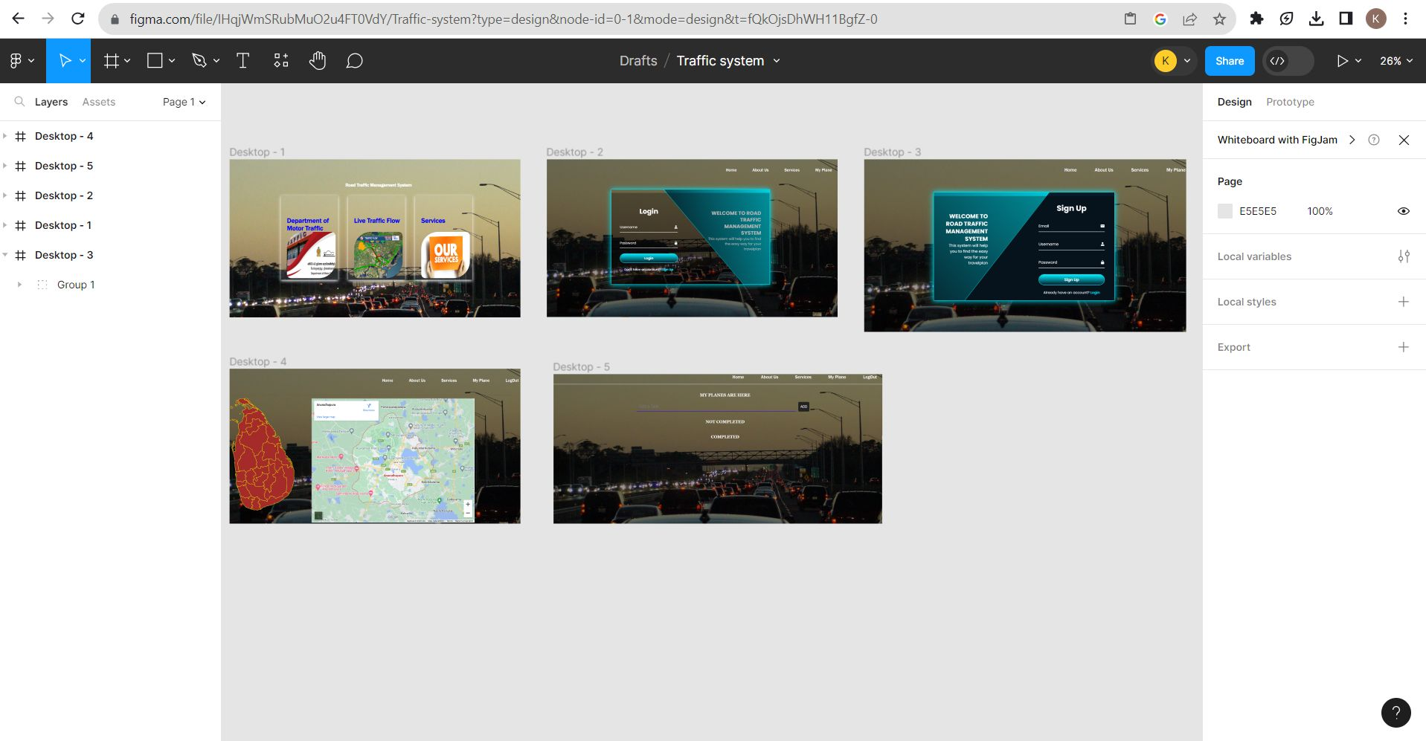
Prototyping of the Project
Low fidelity (Figma)

Slide 10
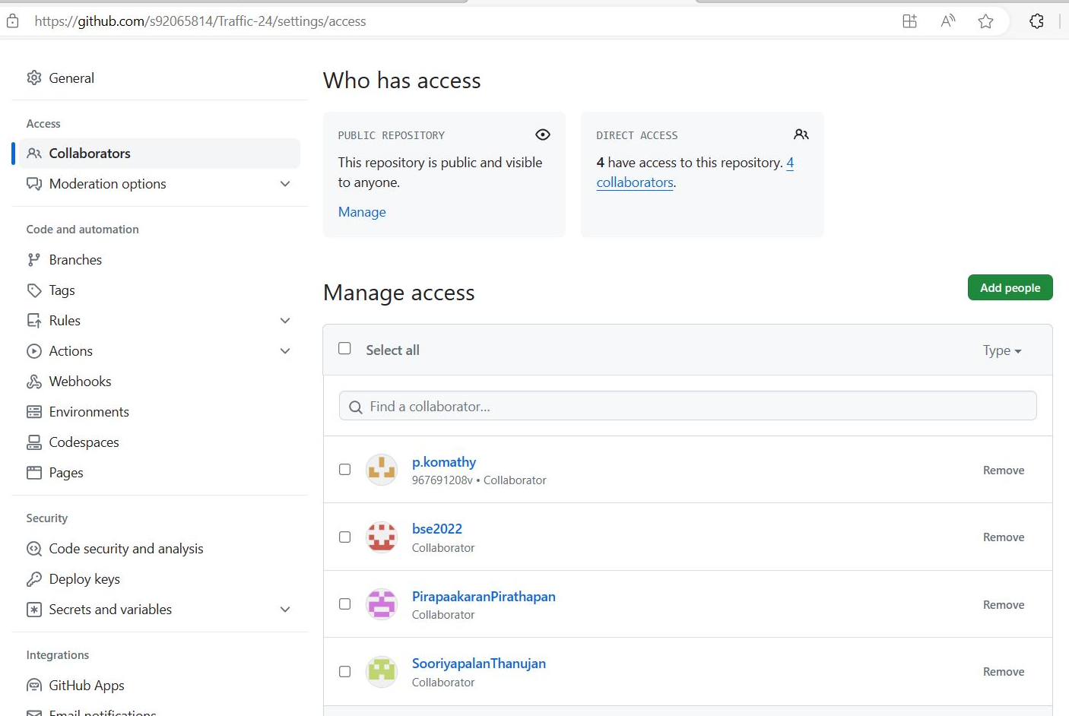
Management of GIT repository

Slide 11
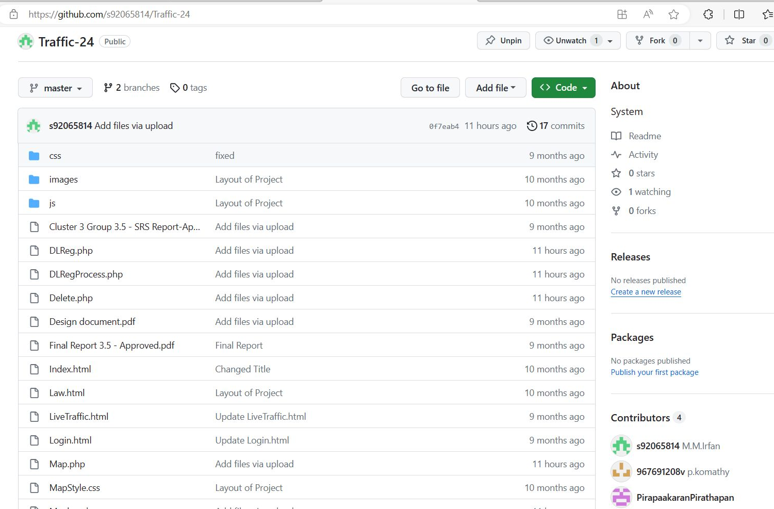
Management of GIT repository
s92065814/Traffic-24: System (github.com)

Slide 12
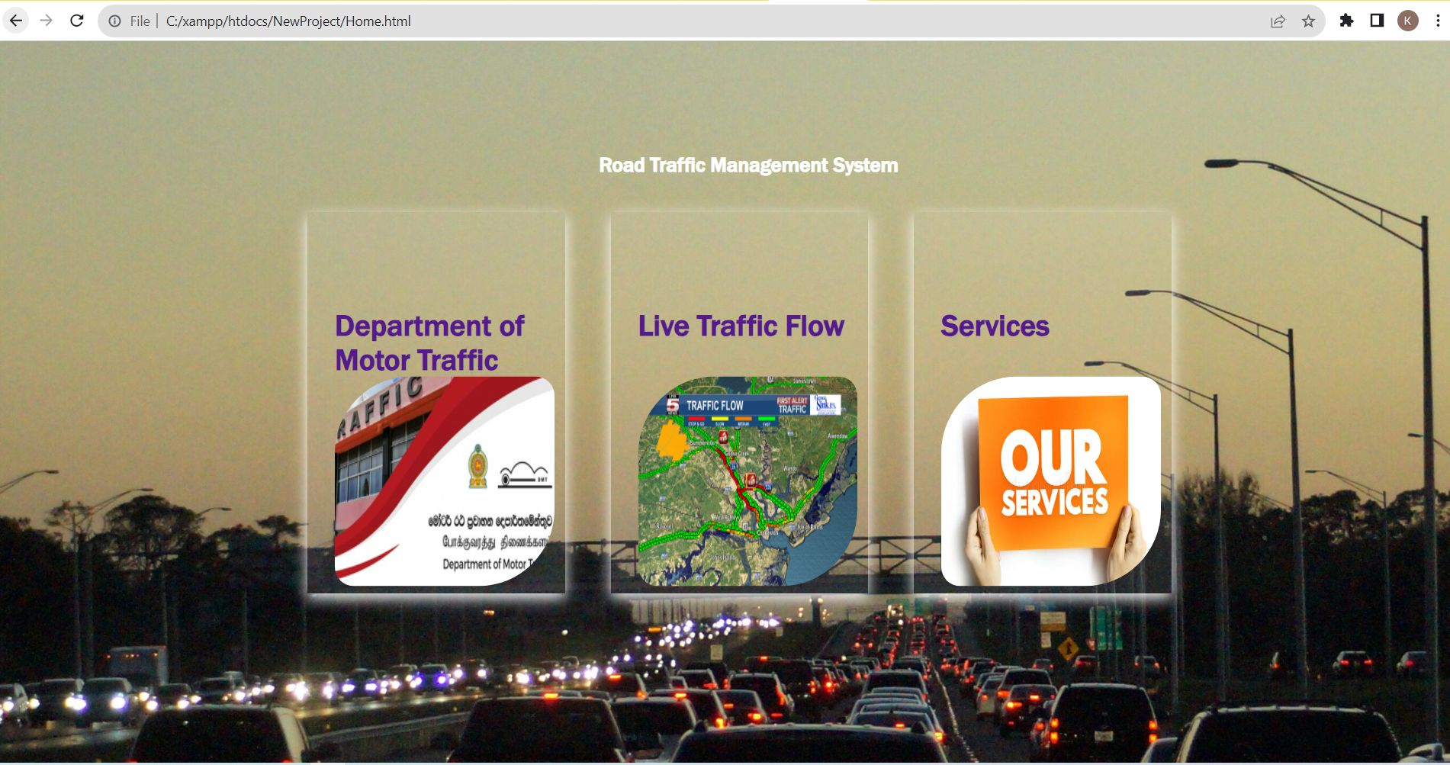
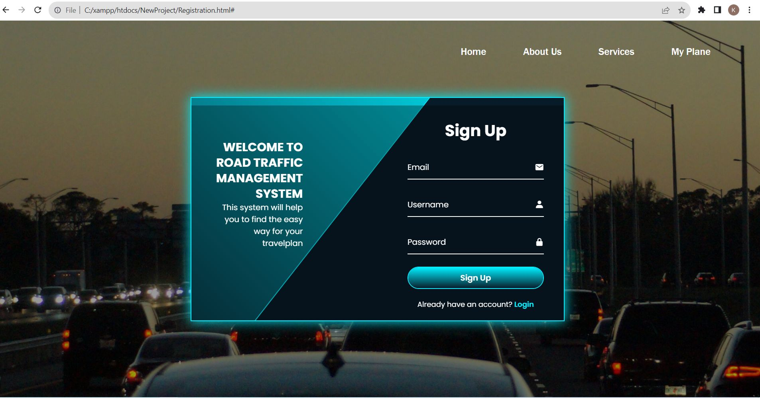
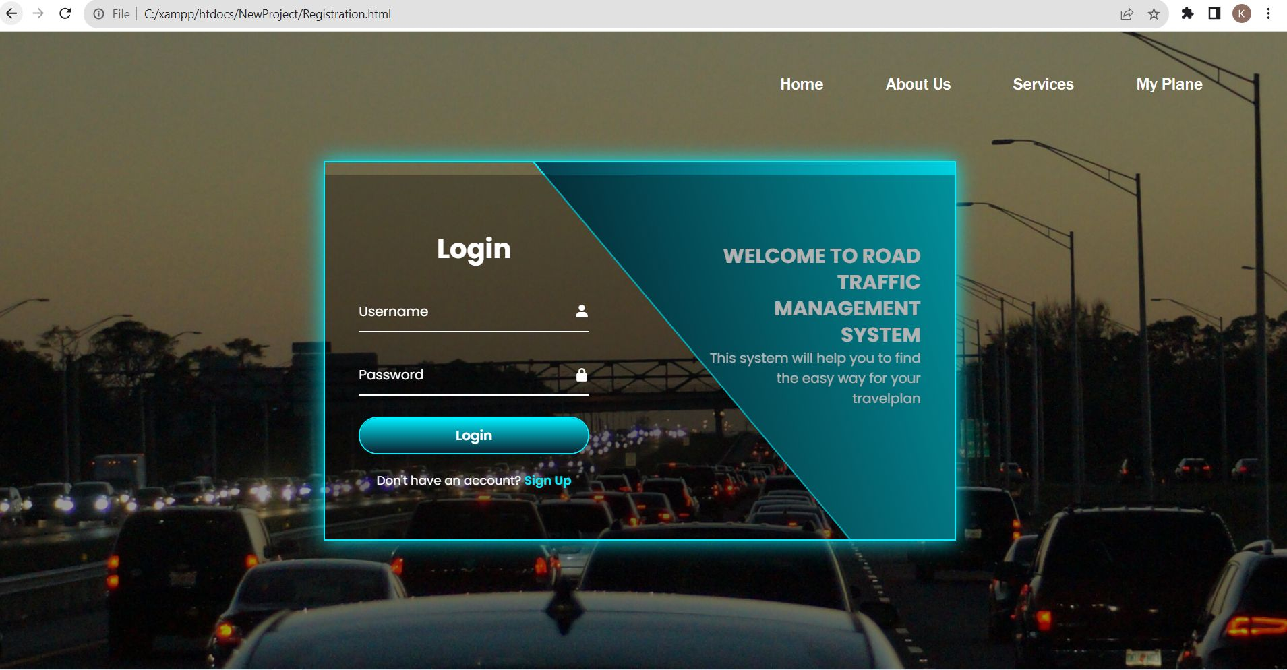
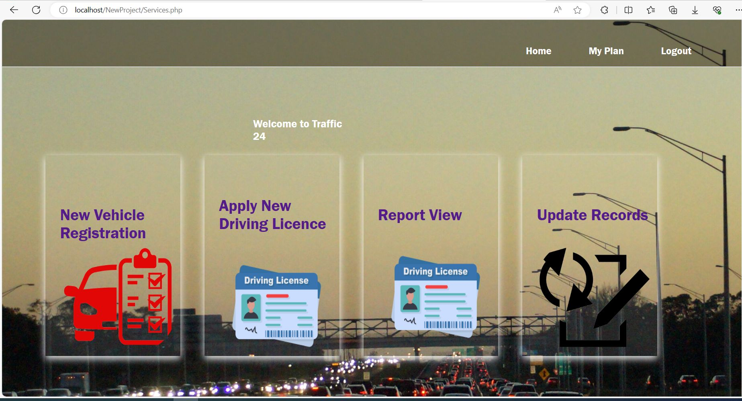
Output of the project:

Slide 13
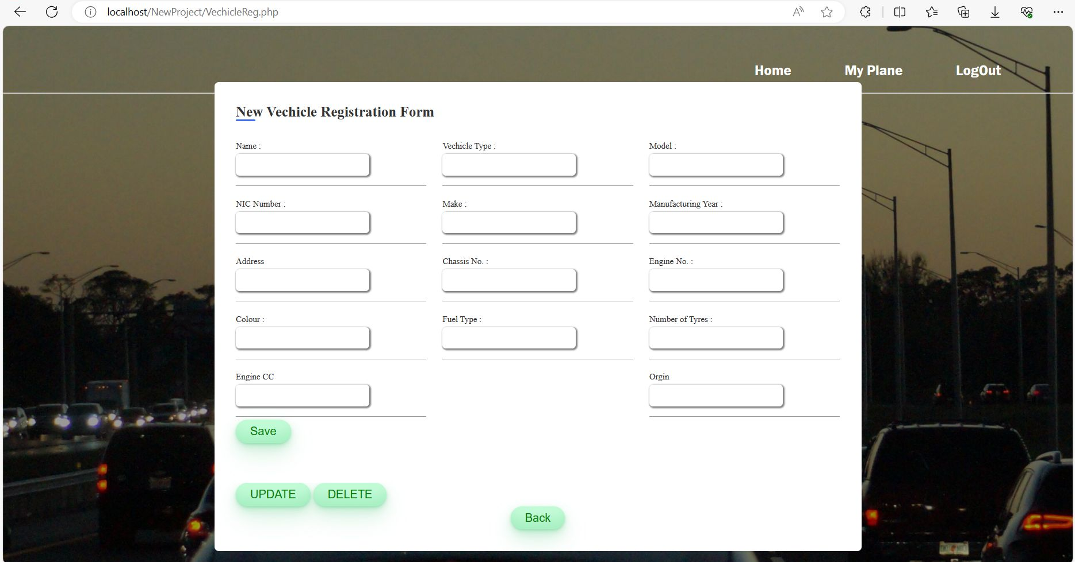
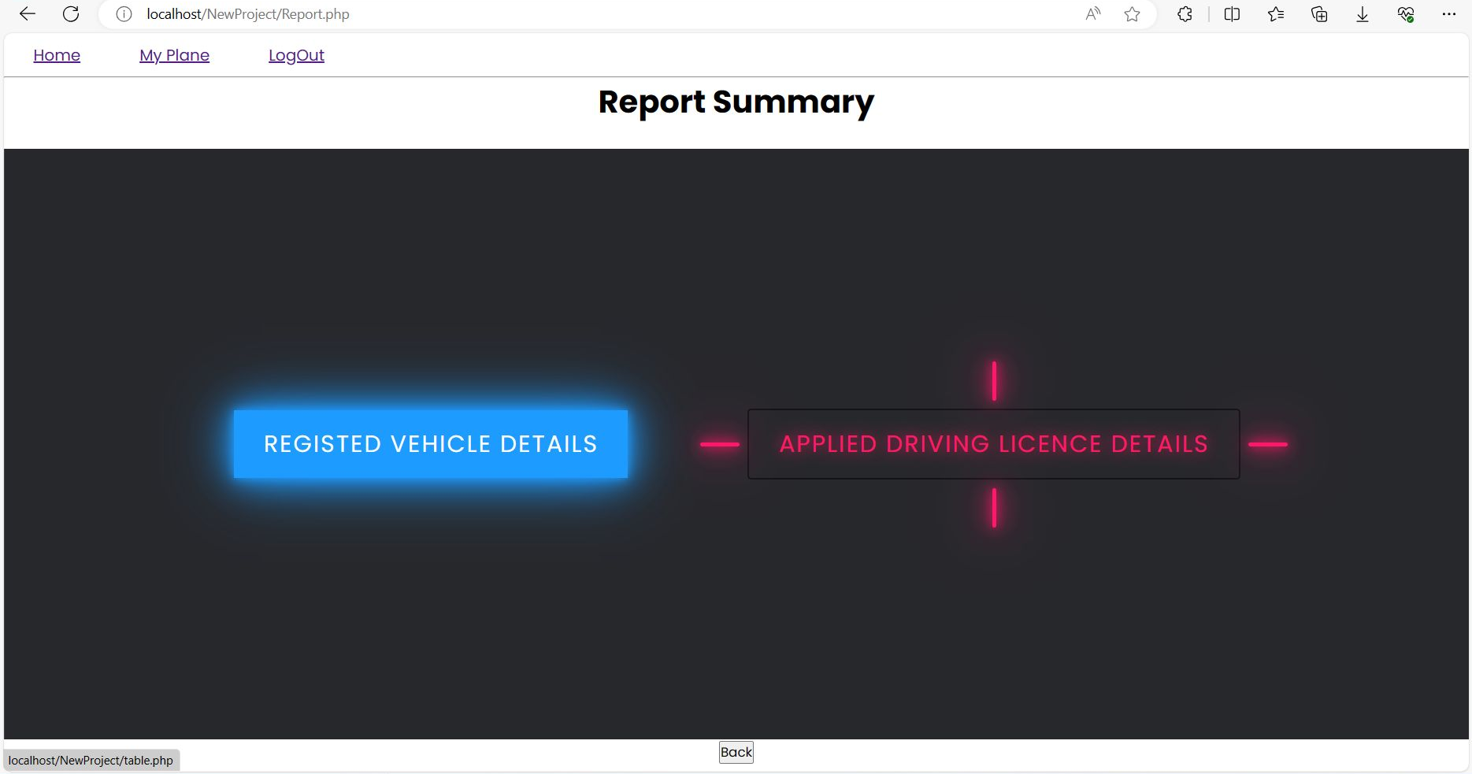
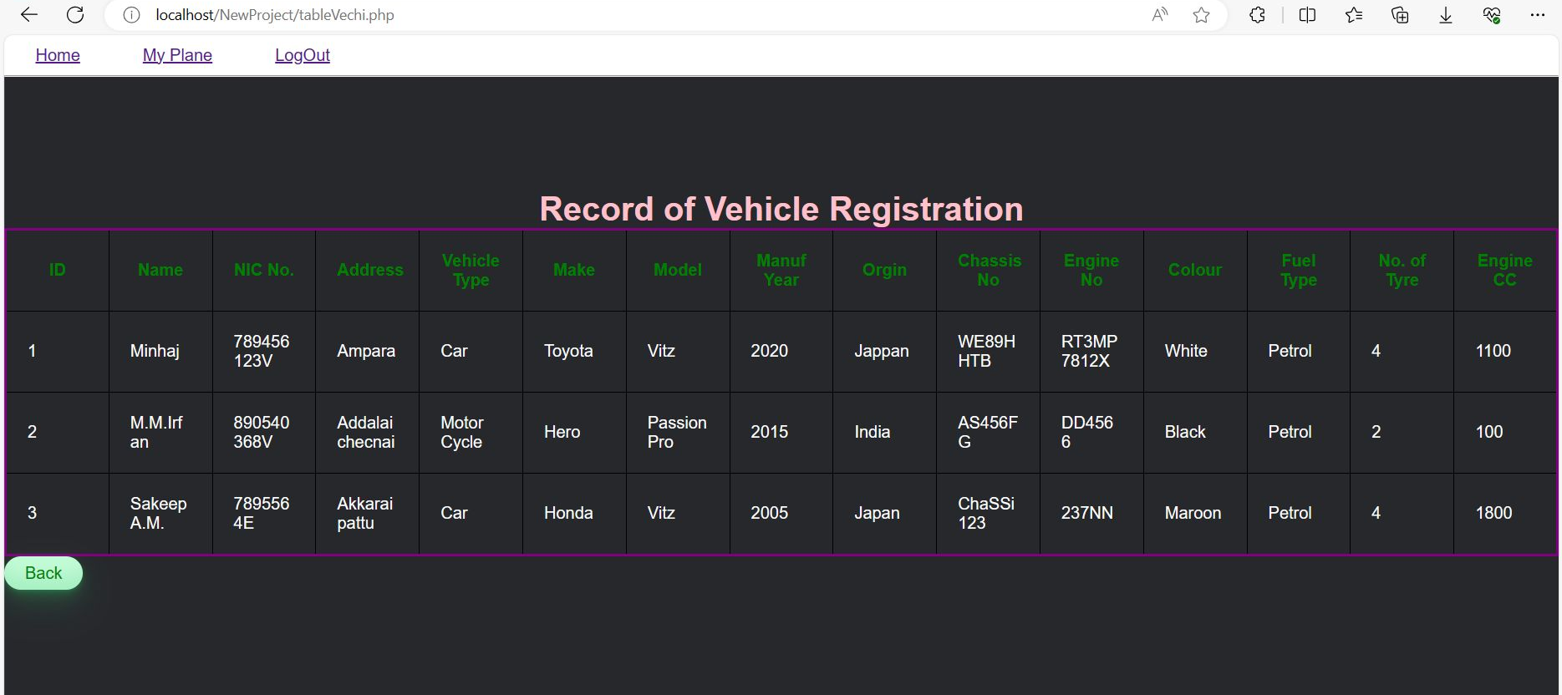
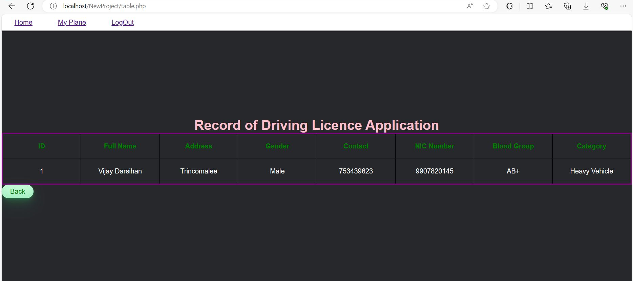
Output of the project:

Slide 14
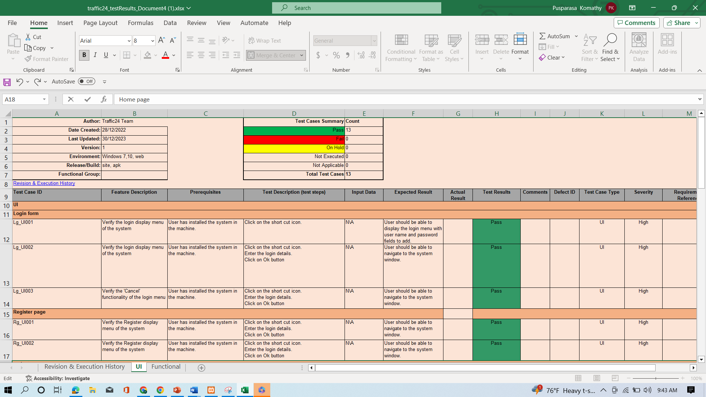
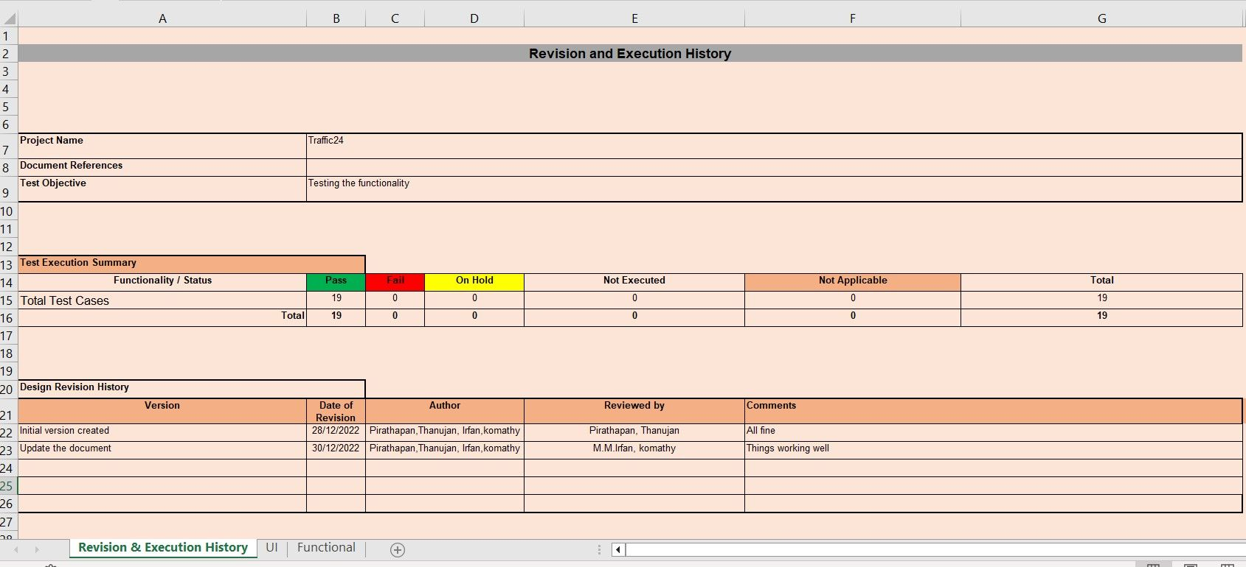
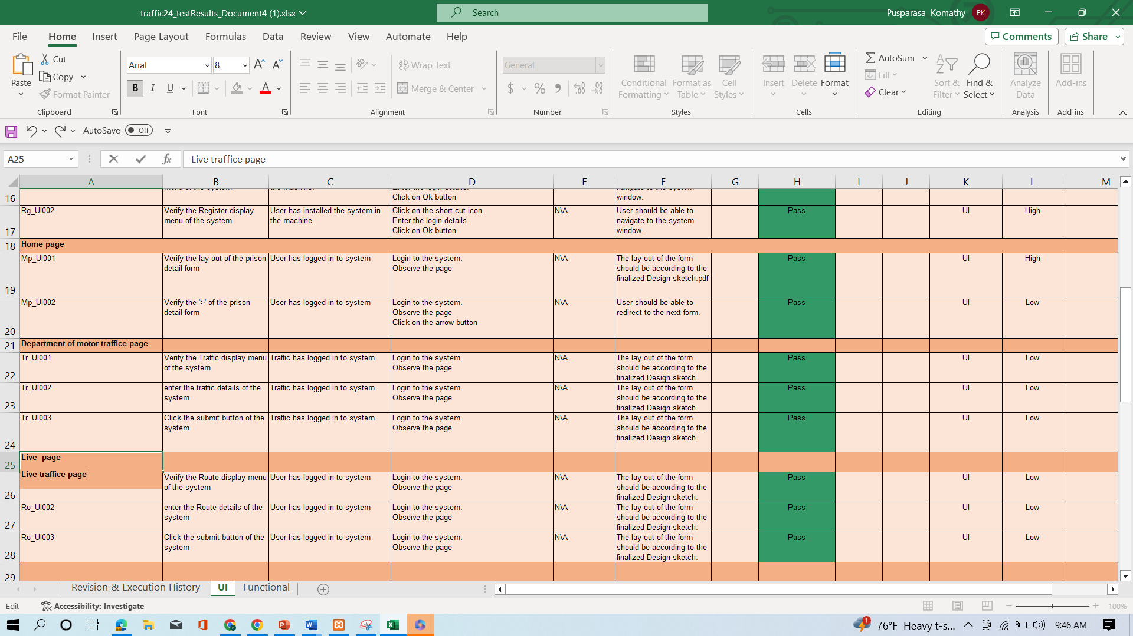
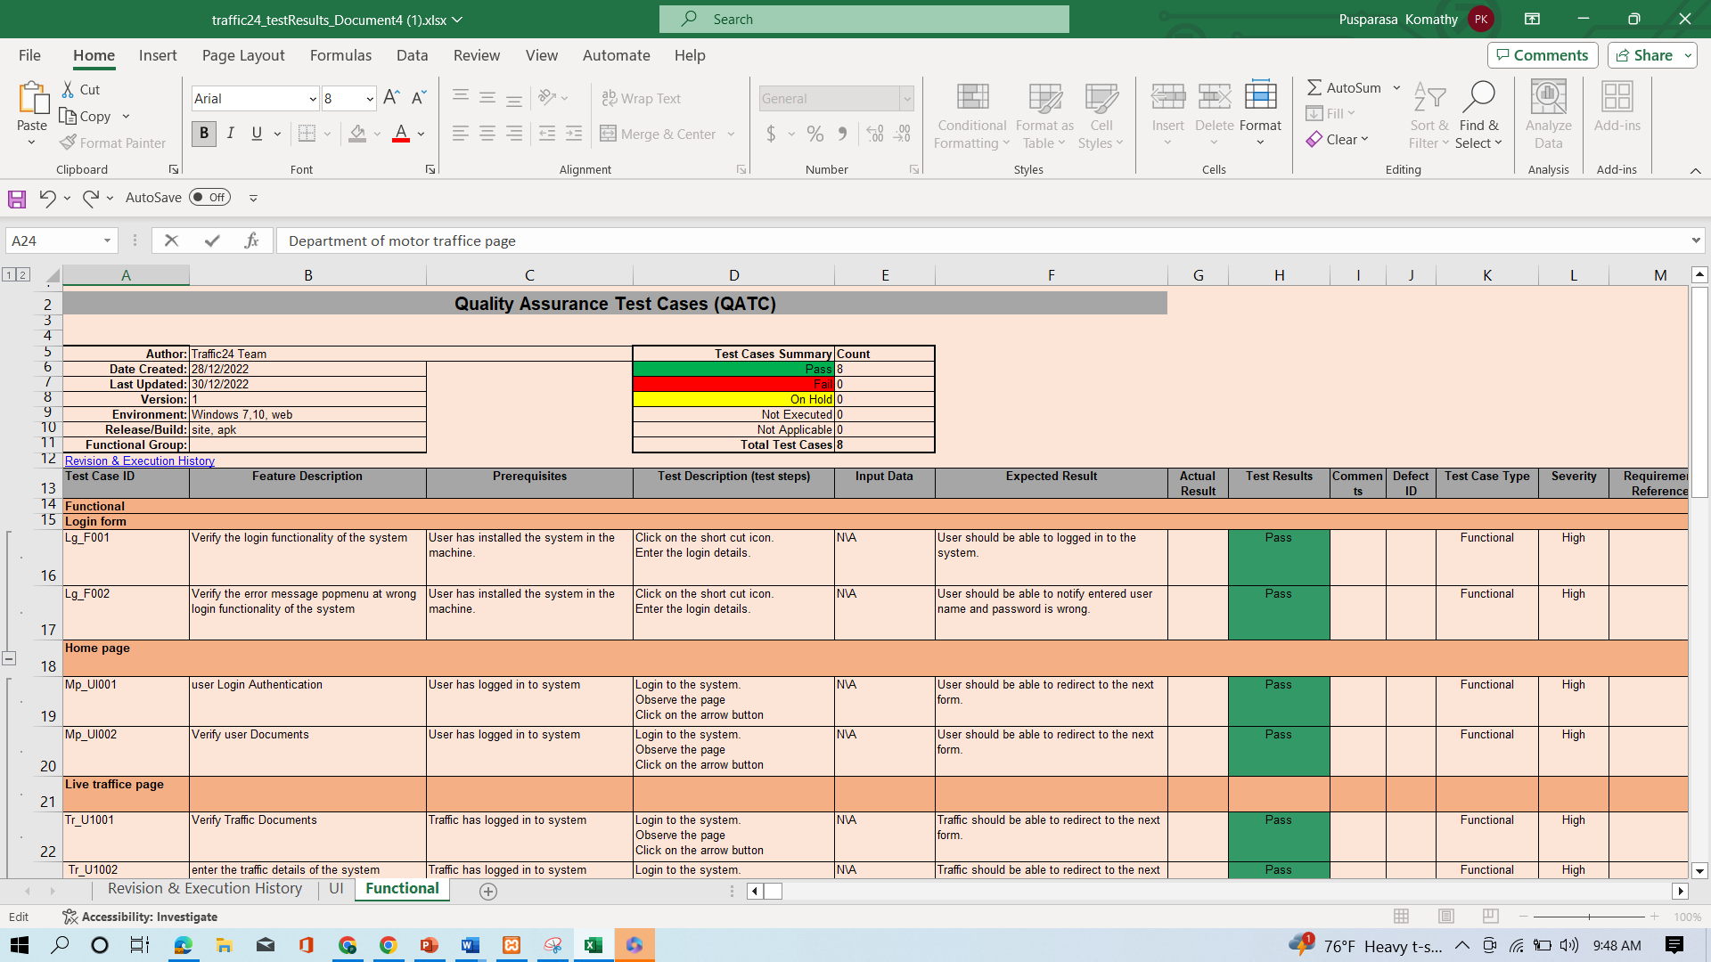
Test Cases

Slide 15
Conclusion:
This project stands as a testament to our commitment to safer roads, efficient transportation, and the harmonious coexistence of diverse road users.
By addressing the limitations and staying dedicated to our objectives, we believe our system can play a pivotal role in reshaping the future of urban transportation in Sri Lanka and beyond.

Slide 16
Thank you
Ahalikai
Approved

